Slide 1
Speed Up Marketing with Strategic Collaboration
Resource Sharing
Enhanced Market Intelligence
Expanded Distribution Networks
Co-Branding Efforts

Slide 2
Resource Sharing
Strategic collaborations allow brands to pool resources such as capital, technology, and human skills, which can expedite many marketing processes.
For instance, a small tech company might partner with a larger firm to access advanced R&D facilities, reducing the time needed to innovate and improve products.
2

Slide 3

Enhanced Market Intelligence
By collaborating, companies can combine their market research efforts and share insights into consumer behavior and preferences.
This shared knowledge can lead to a faster understanding of market needs and quicker implementation of effective marketing strategies.
3

Slide 4
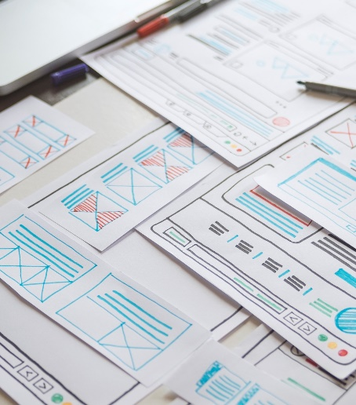

Expanded Distribution Networks
Partnerships can open up new distribution channels. A local brand could partner with an international company to tap into a global distribution network, significantly speeding up its international market penetration and reducing the time to market.
Brought to you by https://JamesSackey.marketing
4

Slide 5
Co-Branding and
Co-Marketing Efforts
Collaborations often lead to co-branding and
co-marketing opportunities, where partners jointly promote their products.
This can reduce marketing costs and time as each partner leverages the other’s marketing channels and customer base, increasing the speed and efficiency of their promotional activities.
Brought to you by https://JamesSackey.marketing

Slide 6
Challenges in Accelerated Marketing
Market Saturation
Culture
Rapid market entry can lead to product influx.
Setbacks from ignoring culture misalignment.
Quality Control
Speeding up processes can compromise quality.
Brand Alignment
Legal & Ethical
Ensuring consistency in messaging.
Faster pace can lead to cut corners.
6

Slide 7


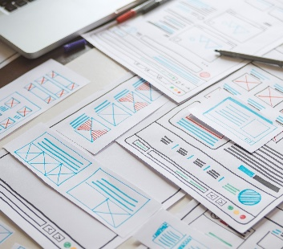

Message me to learn more about collaboration.
sackeyjames@gmail.com
https://JamesSackey.marketing/services

